Slide 1
Machine Learning for Cyber-Attack Detection in a Networked Production System for CNC Machine

Slide 2
Objective of this project
Design and develop a machine-learning model for cyber-attack detection in a CNC machine.
Identify various types of cyber-attacks that can occur.
Detect cyber-attacks using machine learning algorithms.
Types of attacks considered are Access Attack, DoS, MITM, Malicious Software, and Data Manipulation.
Train the model on a dataset of network traffic data generated by the CNC machine.
Evaluate the model's performance in detecting cyber-attacks.

Slide 3
Tasks
Conduct a literature review of techniques for cyber-attack detection in CNC machines using machine learning.
Identify the types of cyber-attacks that can occur in a CNC machine and design a dataset with examples of these attacks.
Pre-process and feature engineer the dataset to prepare it for the machine learning model.
Train the model using an appropriate machine learning algorithm.
Evaluate the model's performance in detecting cyber-attacks and compare it with other techniques for cyber-attack detection in CNC machines.

Slide 4
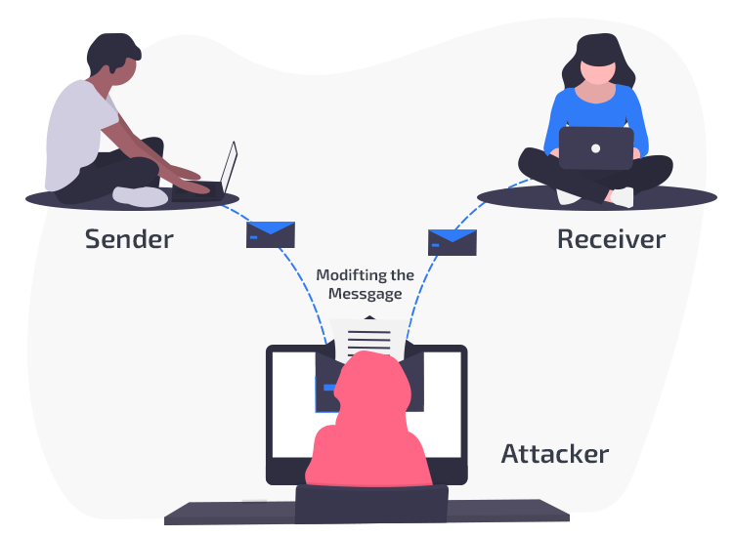
Access Attack

Slide 5
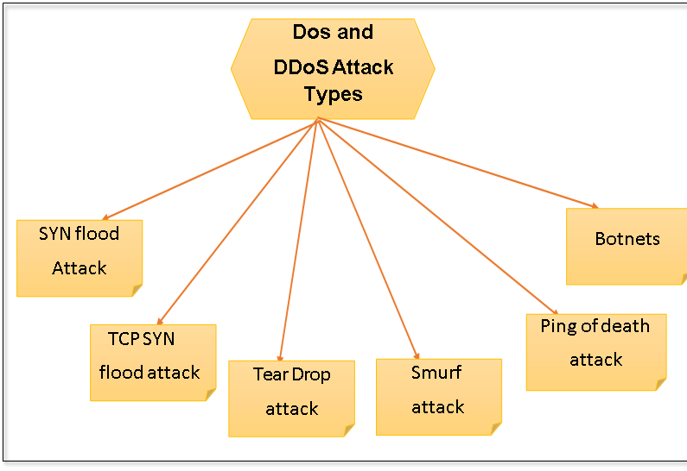
Denial-of-Service Attack (DoS)

Slide 6
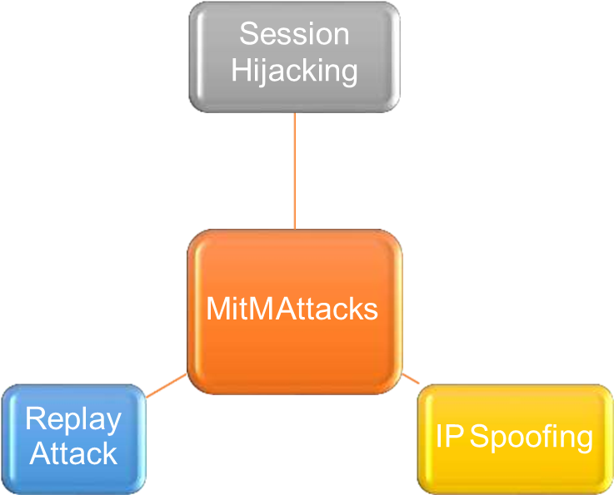
Types of MITM Attack

Slide 7
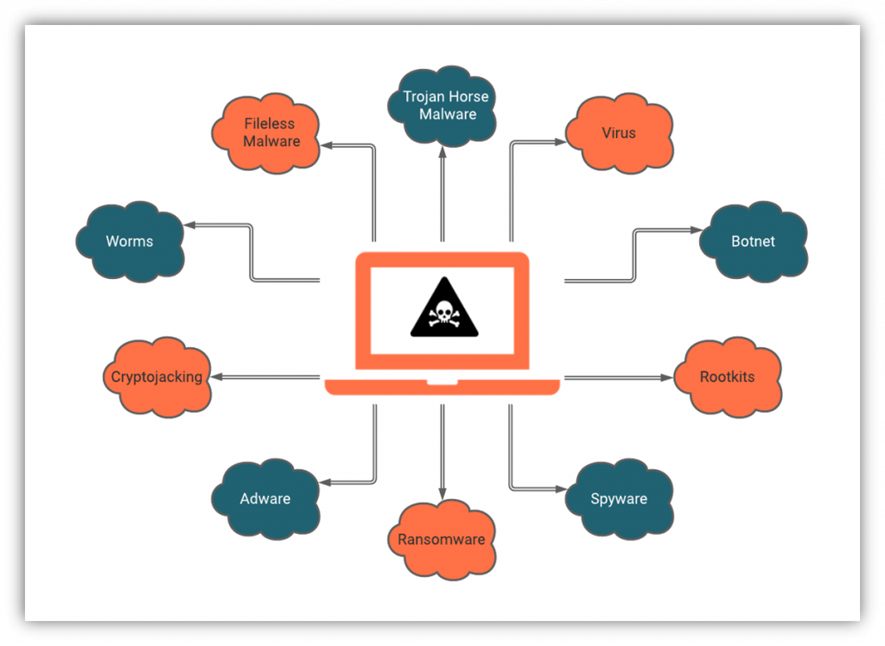
Malicious Software

Slide 8
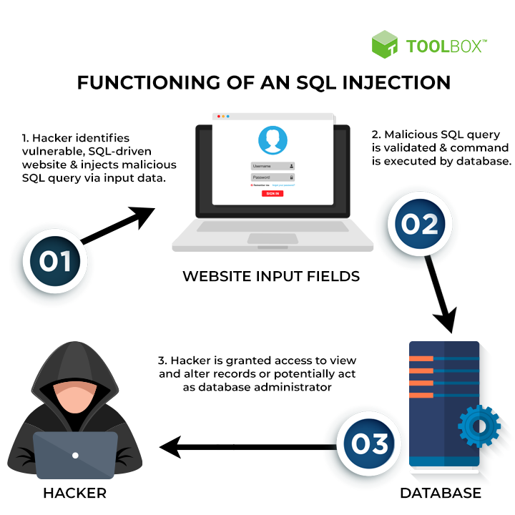
Data Manipulation

Slide 9
Synthetic Data
Timestamp
Source IP
Source Port Protocol
Source Port
Destination IP
Destination Port Protocol
Destination Port
Machine ID
Machine Name
Machine Status
Machine Comment
Packet Type
Packet Size
Machine Network Log
Source IP Type
Destination IP Type
Duration
Flow ID
Number of Packets
Direction
Network Interface
VLAN ID

Slide 10
Feature Selection
Correlation: Correlation analysis can be used to identify features that are highly correlated with the target variable and therefore, more likely to be useful for predicting the target variable.
Mutual information : Mutual information can be used to identify features that are informative about the target variable.

Slide 11
Intrusion System
Train your machine learning model on a dataset of network traffic data.
Save the trained model to a file using the pickle module.
Write a Python script that captures and analyzes network traffic in real-time using a library like ‘pcapy’ or ‘scapy’.
Load the trained machine learning model from the saved file.
Feed incoming network traffic into the machine learning model for analysis.
Take appropriate action based on the model's predictions (e.g., block IP address, send alert).
Use a tool like ‘NSSM’ or ‘pywin32’ to run the Python script as a Windows service.

